Slide 1



AI Research Enhancement through Networked Agents
A sovereign, generative and agentic AI environment integrated with the European Open Science Cloud (EOSC)
|
#eoscarena
#AI4EOSC

Slide 2
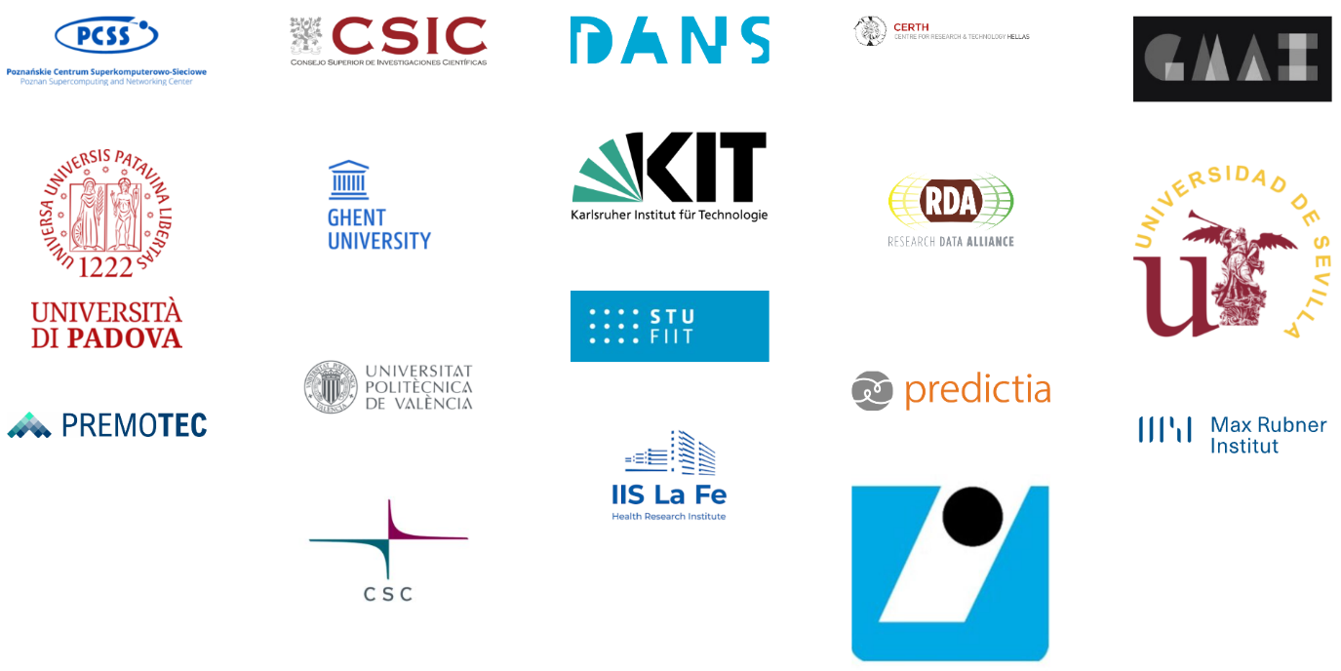


Mission & Ambition
EOSC-ARENA serves as a scientific assistant supporting the full research lifecycle, from literature review and hypothesis generation to analysis, reporting, and provenance capture.
Coordinated by Poznan Supercomputing and Networking Center (PSNC), with Consejo Superior de Investigacione Científicas (CSIC) in the role of Technical and Scientific coordinator, EOSC-ARENA brings together a pan-European consortium to address the use of smart algorithms and AI/ML services in scientific research, with model and data sovereignty at its core.
1
Human-centered AI
2
Responsible use
3
Research integrity
4
Transparency & trustworthiness
5
Provenance & quality
|
#eoscarena
#AI4EOSC
2 / 14

Slide 3
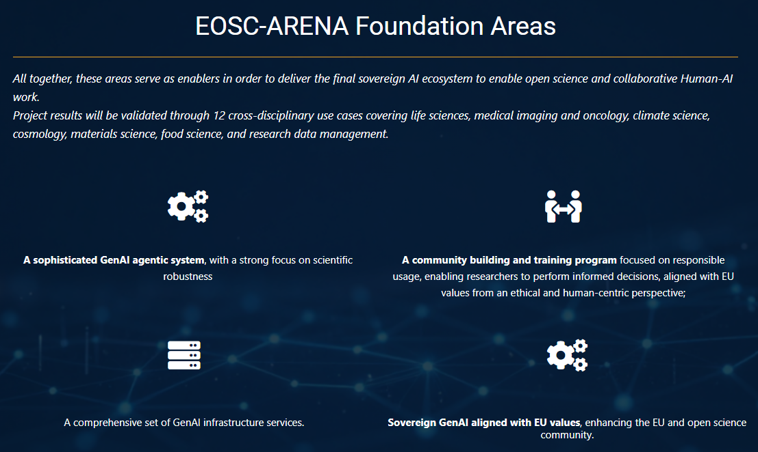

EOSC-ARENA Foundation Areas
EOSC-ARENA is structured in three different foundational areas that serve as the basic layer to further develop this concept.
A set of infrastructure services and platforms, compatible with the existing AI4EOSC platform and derivatives, focused on filling the gap of GenAI application needs (e.g., federated inference services, secure information retrieval and enrichment services.)
A GenAI agentic system and a set of specific GenAI models that can be exploited to assist researchers across their research activity, also providing access to agent and model marketplaces within the EOSC.
Community development and skills building, focused on ethical, responsible and trustworthy usage of GenAI in scientific research, aligned with EU values.
The three previous areas enforce our focus on enhancing the EU and open science community by enabling collaborative work ecosystem to improve the openness, fairness and reproducibility of GenAI assets throughout the research data and models lifecycle supported by EOSC.
|
#eoscarena
#AI4EOSC
8 / 14

Slide 4
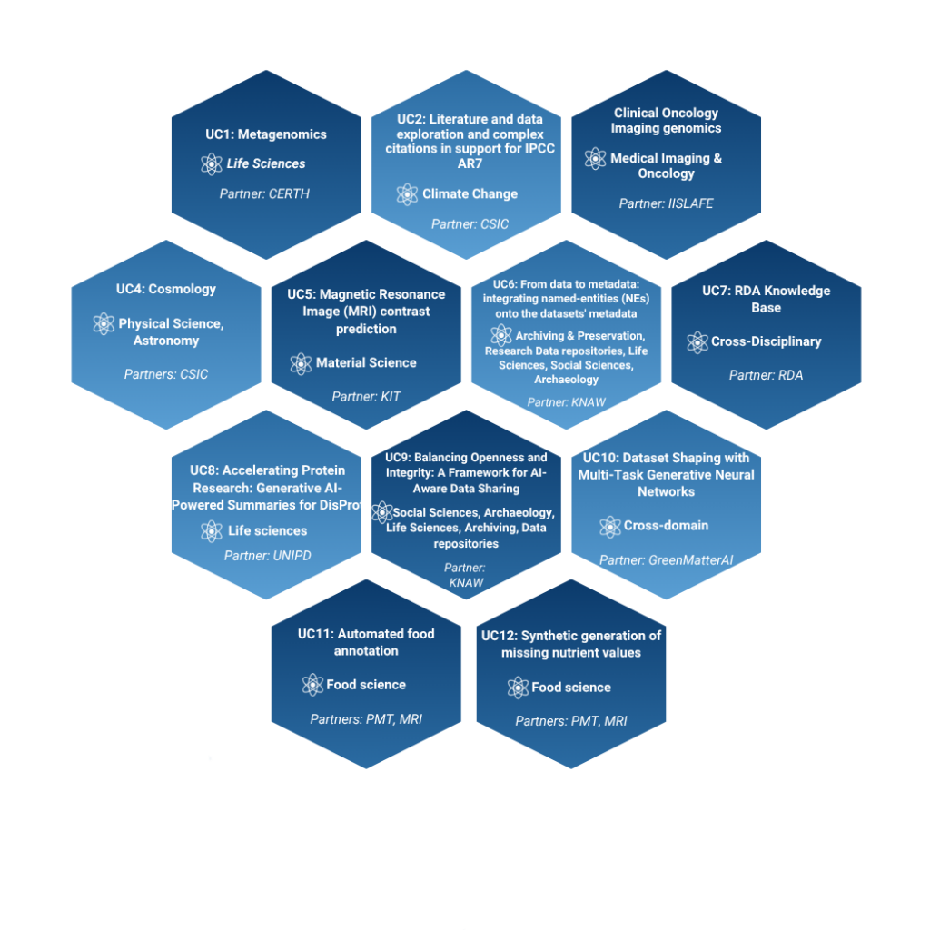
Results validated through real-life use cases
In order to co-design, implement and validate the EOSC-ARENA concept, the project selected a set of different use cases that will be instrumental in order to assess the effectiveness of the project results.
The project use cases have been selected and structured to cover a wide range of real-life use cases from a variety of scientific disciplines.
Life sciences
Medical imaging & oncology
Climate science
Cosmology
Materials science
Food science
Research data management
|
#eoscarena
#AI4EOSC
8 / 14

Slide 5







Follow us & Get in touch
arena.ai4eosc.eu
eosc-arena@pcss.pl
linkedin.com/company/eosc-arena
@EOSCArena
eosc-arena.bsky.social
11 / 14

